Slide 1
SQL Security Principals 101
William Assaf,
He/Him,
Title,
Company

Slide 2
Explore PASS

Slide 4

William Assaf
Principal Consultant, Microsoft MVP, PASS Regional Mentor
He/Him
Title
Company
in/williamdassaf
@william_a_dba
SQLTact.com
Co-author, Microsoft Press, SQL Server Administration Inside Out 2017, 2019
Notes:
Information on me, I’ve spent the last 12 years as a consultant and most recently a principal consultant and leader a SQL Server consulting team, and only I the last few weeks have I accepted a position with Microosft on the SQL content development team.
Finally, throughout this presentation I may reference a script in a “toolbox”. Just for the low low price of attending this session, I’ve included a toolbox of SQL Server scripts to accompany this presentation. It’s available for download on the PASS Summit website accompanying this presentation.

Slide 5
Agenda
Logins, Users, and Authentication
Roles, “Ownership”, Schemas
Auth to Azure SQL DB
Useful permissions, scenarios
SQL Injection
Demo
Toolbox
Notes:
Today we’re going to cover a lot of important foundational material about security, accounts, authentication. For folks new to SQL Server security design and administration, this will be a great foundation for your learning. For those experienced in SQL admin, this will be a thorough evaluation of what you know, or thought you know, and maybe some gaps in what you know. I think there is content in here to interest everyone in the SQL career lifecycle, and I’m not just guessing at that. I got my first DBA job in 2006. I’ve been giving a presentation on Security at User Groups and SQLSaturdays basics for years, it was one of the first topics I started speaking technically on a decade ago. As my own experience has deepened and broadened throughout my career, so has the content I build into this presentation. So I’m going to start basic, and build quickly from there, focusing my content around common hurdles and tasks that database administrators face, in the hopes of deepening or broadening your experience, as well.
This is session one of a four part Learning Pathway on security. In subsequent presentations over the next three days,
John Morehouse is presenting part two, Understanding Modern Data Encryption Offerings for SQL Server, including a lot more information on all the various sorts of encryption, plus some important security features of SQL Server like Transparent Data Encryption and Always encrypted.
Jeff Renz is presenting on Securing Your Data In Azure: Tips and Tricks, which covers Advanced Threat Detection, the Azure Key Vault, cloud secure connection strings, and certified data sets for security in PowerBI.
Ed Leighton-Dick will cap it off with a presentation on Building a Security Dashboard for SQL Server, talking about when certs expire and what does that actually mean, more on Azure Advanced Threat Detection, SQL Audit and monitoring.
But today we’re setting the stage for a good conversation around security at PASS Virtual Summit 2020, especially around how permissions behave inside each database, how you can design database security, the relationships between logins, users, and databases. We’re start first by introducing the way security things are normal configured, but we’ll also discuss weird ways they veer from the normal.

Slide 6
Principal vs Principle
Principal
(noun) a person who is in charge of some responsibility
Example: The principal consultant talked to the school’s principal.
(adj) original, most important
Example: The principal aim of a good DBA is to defeat wicked developers.
Principle
(noun) a rule, guideline or fact
Example: Our guiding principles are based on science.
Notes:
So this is a common grammar issue in the English language, the difference between principal, P-A-L and principle, P-L-E.
Both can be a noun, but PAL describes a person, a person who could be your “pal”. A principle PLE is an inanimate thing, like guiding principles, or being principled, a way to describe someone who follows a moral or ethical code.
So today, we’re really talking about both today. Principals, PAL, are not only what SQL Server calls security objects in the database, Principles, PLE, that guide how we as DBA’s should design and create securables in our servers and database.

Slide 7
A Principal’s Principles
We can all be Principled Principals
who follow Principal Principles of security.
Notes:
My title at my last consultant company was Principal Consultant, so this Principal is going to share with you his Security Principals.
You’ll see Principals, PAL, in

Slide 8
Why is Security Important?
Proper implementation of SQL security principals:
Decreases administrative effort
Decreases application complexity
Decreases database surface area

Slide 9
Login vs User
Database User
Server Login
Has a database context
Often linked to a Login*
Does not have a password*
Stored in a Database
Included in DB Restore
Given access to SELECT, UPDATE, EXECUTE, CREATE TABLE, etc.
*Most of the time. We’ll talk about it.
Connects to a SQL Instance
Linked to AD (Windows Auth)
or has a password (SQL Auth)
Stored in the Master database, so not in other DB restores
Given access to CONNECT, VIEW SERVER STATE, CREATE DATABASE, etc.

Slide 10
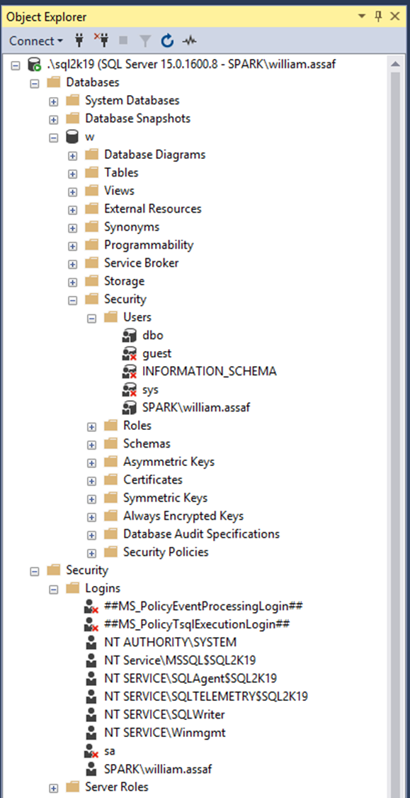
Login vs User
Database User
Server Login
Has a database context
Often linked to a Login*
Does not have a password*
Stored in a Database
Included in DB Restore
*Most of the time. We’ll talk about it.
Connects to a SQL Instance
Linked to AD (Windows Auth) or have a password (SQL Auth)
Stored in the Master database, so is not included in other DB restores
Notes:
Same info here, but we’re looking at object explorer in SQL Server Management Studio. …

Slide 11
AD Security Groups
Create logins for to AD Security Groups, not individuals. Insist on it.
Be aware of who is a member of those groups, and what groups are a member of groups, and what groups are a member of those groups…
Notes:
Devs -> App Support -> QA -> Financial Analysts…

Slide 12
AD Security Groups
You can interrogate AD for the members of security groups
EXEC master..xp_logininfo
@acctname = 'domain\groupname',
@option = 'members'
BUT it only returns FIRST level members, not recursive. Instead use PowerShell:
Get-ADGroupMember -identity 'Development' -recursive

Slide 13
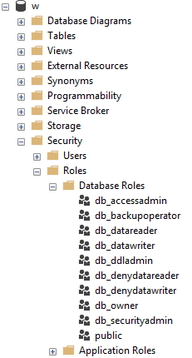
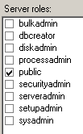
Server and Database Built-in Roles
Roles are security principals too
Logins added to Server Roles
Users added to Database Roles
Built-in Roles to provide a standard for access that may be too broad.
Follow principles of RBAC.
Notes:
<read slide first> RBAC is an acronym many in the governance area are familiar with, the idea that nobody gets permissions that are unique to them, they are only granted permissions based on their role, not their individual needs. Role Based Access Control means that creating specific permissions is a meaningful exercise, because it’ll be applied to members of a group. The last thing you want to end up with are many SQL Logins, each with their own permissions. This would make application maintenance and proper security auditing a nightmare. Instead, you should work with developers to identify permissions needed per role, and then create custom Server Role and/or Database roles to grant those permissions.
When granting permissions to a role, assign more specific permissions when possible. While you can add a role to the built-in database roles, like db_datareader or db_datawriter, that might be overreach. Your data within a database may not be homogenous in terms of sensitivity/permissions to access.
Later, we’ll talk about schemas, these are also security principals, and great way to grant more specific permissions than to all objects in a database.
Last on these sample images here, you’ll notice the public roles at both the server and database level, and how that server role public checkbox is always checked. And it can’t be unchecked. Let’s talk about public.

Slide 14
Public
Every login/user is a member of “public” roles.
All logins/users inherit permissions granted to public.
Public is a server role that should never be granted any additional permissions, authorization or ownership.
Public is also a database role. Every database user/role belongs to a public database role.
Notes:
<read notes instead>
Every login is a member of the public server role. Every user in each database is a member of the that database’s public database role.
Only very lazy and short-sighted developers would grant permissions to public, which allows every user that does or ever will exist, to inherit permissions.
Permissions assigned to the public role is a clear sign of lazy developers. Don’t be a lazy developer.

Slide 15
Public
Should fail any app security audit or DB audit. Trust me.
Expected non-issue findings from Database Diagram feature.
A pain to unravel.
Check for this.
Toolbox: 1 - public permissions.sql
Notes:
<read slide first>The strategy to undo a security architecture based around public can be complicated, involves lots of testing, almost certainly requires participation from the developers to figure out what permissions are actually needed.

Slide 16
Guest
Special built-in user in each database.
Any login that doesn’t have a mapped user in a database inherits GUEST.
By default, this is disabled in all databases.
Check for this.
Toolbox: 2 - guest permissions.sql
Notes:
<read slide first>
For what should be very obvious reasons, never grant any permissions, even CONNECT, to GUEST, unless you understand what you’re doing.
If a login doesn’t have a user in a database, it shouldn’t have access to the database.
Not a secure solution for future access. Similarly, this could also trip a SQL Server security audit failure.

Slide 17
Server Logins
Logins are given a default database.
CONNECT will fail if the Default Database is not accessible.
Best practice: set Default Database to the intended User Database, or to TempDB, which is always there, but not persistent.
Notes:
<read notes first>
Again, a SQL Server Login is a server-level security principal
A User is a database-level principal
<click>

Slide 18
Server Logins + Database Users
A Server Login is what authenticates a connection to SQL.
A Database User provides a Login with database access.
Notes:
<read slide first>
“Login” is a server level security principal.
“User” is a database level security principal.
Now, let’s talk about the different types of SQL Server Logins, they’re differentiated by how they authenticated to SQL Server.

Slide 19
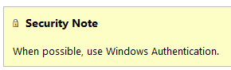
SQL Authenticated Logins
SQL Logins are authenticated by a SQL Server instance.
“Enforce Password Policy” encouraged, but not required!?
More administrative effort to maintain, migrate, secure.
Notes:
1. We’ll talk more about this but this means each SQL Server is now an authority for its own credentials. If you have 10 SQL Server instances, that 10 different sets of logins and passwords to maintain, as opposed to one Active Directory.
2. Strongly encouraged to Enforce password policy, which can include password expiration, inheriting from the same settings in Windows.
Unfortunately, the password policy is optional! Password could be password, empty string, or the same as the user name.
Also, if a login doesn’t currently have the password policy enforced, you can check the box, but it doesn’t apply to the current password. So it’s way too easy to mark a login to apply policy, but have a password that is NOT strong enough to meet policy. The policy would only then be checked if it is changed.
3. Multiple failed SQL auth login attempts will Lock Out, which a DBA must resolve. Because these credentials are specific to each instance, it also means that SQL logins must be kept synchronized, more or less manually, between replicas in an Availability group
Finally, see here a plain and clear screenshot from Microsoft Docs. Use Windows Auth when possible. Don’t even enable SQL Auth unless you have to – it’s not enabled by default when you go to install SQL Server. You have to go out of your way to configure the instance in Mixed Mode, which enables SQL Logins and allows the built-in “sa” account to be enabled.

Slide 20
SQL Auth Passwords
Check for weak or easily predicted passwords.
Compare hash results to sys.sql_logins.password_hash.
Toolbox – 3 easy passwords.sql
Notes:
<read notes> Let’s talk more about the optional password policy in SQL Server.
If you’re a sysadmin, you can perform what is essentially a rainbow attack against your own SQL Server to look for weak or easily predicted passwords. You can do this because SQL Server makes the one-way password hash function available to you. So you can run any string through the hashing function, then, compare the one-way hash to what SQL Server stores. So while you can’t reverse engineer or decrypt a password, you can generate a hash of any string, then compare hashes. And you can do all of this without failing a login attempt or locking out a login.

Slide 21
Windows Auth vs SQL Auth
In a typical enterprise business environment,
Windows Authentication means that:
account creation/termination,
security group membership,
password policy,
are all handled by an existing corporate security administration infrastructure.
Notes:
<read notes first>
So we’ve talked about how SQL auth really creates additional administrative overhead and the fragmentation of security for user and even application access. In comparison to Windows Authentication, specifically using Active Directory, SQL Authentication creates a decentralized security setup in each instance.
<click, read slide>
Centralizing account and password management, role assignment, these are good things to do from a governance standpoint and from the standpoint of, that thing you see on Certification Exams all the time? “Least amount of administrative effort”
Proper use of the Windows Authentication model creates Server Logins that are linked to Domain Accounts, Preferably linked to Security Groups in Active directory, not individuals, so that membership is also managed by your existing security infrastructure.
Windows Authenticated Logins can also be created for Local Windows users, local to the Windows Server. This isn’t ideal, creating some of the decentralization and redundancy issues common for SQL Authenticated logins. Don’t recommend them except for potential use in SQL Servers outside of a domain.
In any case, SQL Server inherits the password policy of the local Machine Policy, regardless of whether or not the local Machine Policy is inherited from a Domain Policy.

Slide 22
Windows Auth and Apps
Using Windows Auth requires the OS to authenticate.
In Windows, this is the SSPI, which will authenticate via Kerberos or NTLM. This is non-trivial.
Kerberos requires Service Principal Name (SPN).
NTLM = old MS Authentication protocol that Kerberos replaced.
If you get SSPI issues, it’s likely a double-hop or trust issue.
Use Service Accounts in all cases, SQL or Windows Auth.
Notes:
Now, to be fair, Windows Authentication does have a complexity increase.
<click>
<read slide bullet points 1-5>
<read notes>
You may have encountered this before if trying to use Windows Authentication from an Internet-facing server, like an App Server in a DMZ, or otherwise outside of the domain. Kerberos may be required to authenticate a Windows User directly from the application server to the SQL Server. Can increase the complexity of an application loadout, but this is the Enterprise approach. I don’t have time to do a deep dive on this today, but this is fairly well documented and may involve your Active Directory admins helping to configure.
<click>
This is why I still see SQL Authentication used by many applications, because developers don’t want to have to ship applications that depend on this kind of trust. To be clear, this is less secure.
The best way to design this is that applications that SQL Logins at least use a SQL Login that isn’t used interactively.
When I say interactively, I meant that no human is ever typing in this user name and password. Make the password painfully long, even.
Make sure that developers themselves don’t use the SQL Login, they should still use their own Windows Authentication, even if they are external vendors. A defining characteristic of a Service Account is that nobody knows its password, and at least, it isn’t used interactively.
We’ll talk about service accounts more later on, and especially the different options around Windows Authenticated Service Accounts.

Slide 23
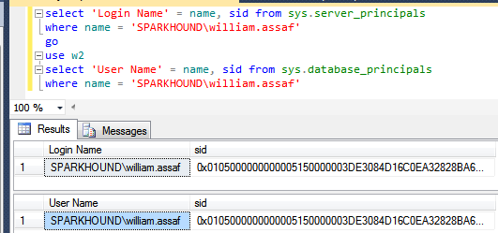
Logins + Users
A User can be linked to any Server Login
The names don’t actually have to match, but they should.
A SID (Security-IDentifier) is shared by User and Login.
Notes:
In Windows Authentication, that SID comes from the Windows provider, likely Active Directory. So in all SQL Servers where that domain account is used, it’s got the same SID.

Slide 24
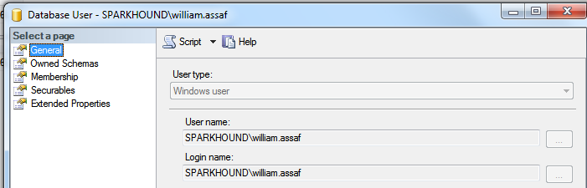
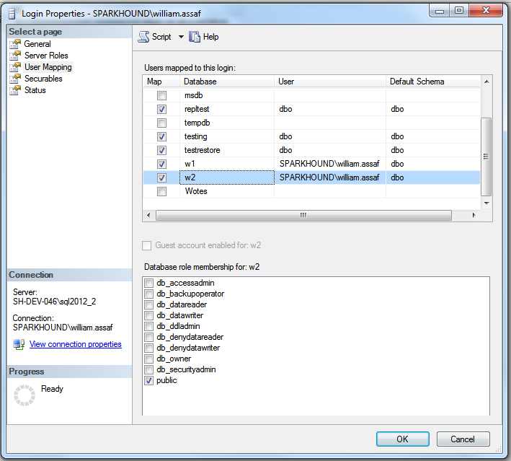
Login Mapping to Database User
Logins are mapped to Users in the User Mapping page of the Login properties dialog.
Notes:
It’s here in the mapping that users take on the SID of the login.
Note here also the user “dbo”, this is a special user in each database that sysadmins can use. We’ll talk more about dbo and its shifting uses over the years later on.

Slide 25
Orphaned SID
DB Users can be disconnected from their SQL Auth Login.
Commonly occurs when a database is restored from one SQL instance to another.
Only with SQL Auth Logins, not Windows Auth Logins.
SQL Auth Login = local SID, Windows Auth Login = AD SID
Notes:
<read slide>
Now, why is that? Why would this only affect SQL Authenticated Logins?
<click>
It’s because, unless you specify a SID yourself, the SID for a SQL Server is generated locally at each SQL instance. IF you got and create a Login named test on 5 different SQL server instances, you’ll get a Login named Test with five different SIDs. There is a way to create a SQL Auth Login with a pre-determined SID, this is how migrations happen, we’ll talk about this in a bit.
If you create a Windows Login for the same Active Directory account on five SQL instances, each Login has the same SID, because all five SQL instances got the SID from the same place, AD. Therefore any user associated with the Login will have the same SID, on any SQL instance. This is becomes incredibly important for Availability Groups, where is much simpler to distribute an Windows Login from AD to each replica, versus distributing a SQL Server authenticated login to each replica, scripting it out to use the same SID in each instance.

Slide 26
Fix Orphaned SID
To re-associate a database user to a server login:
ALTER USER username WITH LOGIN = loginname;
SELECT DBUser_Name = dp.name
, Login_Name = sp.name
FROM sys.database_principals AS dp
INNER JOIN sys.server_principals AS sp
ON dp.name = sp.name
WHERE sp.sid <> dp.sid
Toolbox: 4 – fix orphaned sid.sql
Notes:
Let’s say the login already exists, with two different SIDs, and we need to go ahead and repair the user, to link it back with its Login. The command is actually quite simple. You can also proactively identify orphaned logins by comparing their names and SID in SQL Server’s internal metadata.
<click>
Here’s the basic join, and there’s a script in this session’s toolbox that helps you quickly identify and repair orphaned SIDs. If you’re an experienced DBA, remembering to look for and fix orphaned SIDs is a necessary followup any time a database is restored from one server to another, for example, to update a dev or test environment from production.

Slide 27
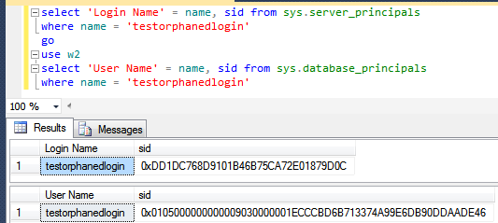
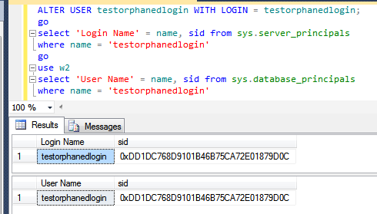
Fix Orphaned SID
Notes:
You’ll know you have a problem with an orphaned SID if the end user or application gets an error like this. “The server principal is not able to access the database under the current security context“, this is a symptom of a mismatched SID.
<click>
And here, we can verify in the system views that indeed, I’ve got a SQL authenticated login and a Database User of the same name, but different SIDs.
<click>
After running ALTER USER with LOGIN, you can see now that the Database User has been modified to reflect the SID of the login on this SQL instance.

Slide 28
SQL Auth Login Migration
Not possible to reverse-engineer a SQL Auth Login password.
Migration of SQL Logins is accomplished by:
Backup+restore of the master database (complicated) -OR-
Creating SQL Logins with same SID but new password (not desirable) -OR-
Generating a hash of the password and same SID (most desirable) Let’s go more into that….
Notes:
<read notes>Like we said earlier it is not possible to reverse-engineer a SQL Auth Login’s password, you can guess it an infinite number of times via the hashing algorithm we discussed earlier, but you can’t see it.
So when migrating SQL Logins from one instance to another during an upgrade or migration, you have options.
<click>
The first option involves restoring the master database, which is obviously only possible in a migration to the exact same SQL Server version. You may also find this more or less impossible if the drive letters are changing, so consider restoring the master database an important disaster recovery option in the event of a baremetal restore, but not an option for server upgrades.
<click>
Scripting out all SQL Logins with the same SID but a new password is possible, but breaks a lot of connection strings, and it’s unnecessary because,
<click>
We can generate that hash of the password, without knowing the password, and using that and the SID, can recreate a login on the other instance. This is easily scriptable. Let’s talk more about that.

Slide 29
SQL Auth Login Migration
Microsoft has provided a pair of sprocs to generate the hash of passwords: support.microsoft.com/kb/918992
sp_hexadecimal + sp_help_revlogin
But don’t forget to migrate the server-level permissions:
Toolbox: security Script servers.sql

Slide 30
SQL Auth Login Migration
Microsoft has provided a pair of sprocs to generate the hash of passwords: support.microsoft.com/kb/918992
sp_hexadecimal + sp_help_revlogin
Create both in master then EXEC sp_help_revlogin
But don’t forget to migrate the server-level permissions:
Toolbox: security Script servers.sql

Slide 31
SQL Auth Login Migration
Microsoft has provided a pair of sprocs to generate the hash of passwords: support.microsoft.com/kb/918992
sp_hexadecimal + sp_help_revlogin
Create both in master then EXEC sp_help_revlogin

Slide 32
SQL Auth Login Migration
Migrating a SQL Login with its password and SID is critical.
Regular proactive check for all replicas in availability groups:
Check that all Logins exist AND All SQL Logins have same SID, hash
Notes:
<read slide first>
This is also important for setting up new Availability Groups, as the Login SIDs must match on every replica. Otherwise, after failover, the master database on the new primary replica, which isn’t replication, won’t match the SID on user database, which is replicated.

Slide 33
SQL Auth Login Migration
But don’t forget to migrate the server-level permissions:
Toolbox: 5 - security Script servers.sql
Notes:
And of course if you’re also doing a migration by restoring or attaching databases from one server to another, the database level permissions come across with the database, but server level permissions are stored in the master database, like we talked about earlier.
And just a reminder, at this point if you have any questions, please use the Audience Response System to ask and I’ll do my best to answer.

Slide 34
Login vs User
Database User
Server Login
Has a database context
Often linked to a Login*
Does not have a password*
Stored in a Database
Included in DB Restore
*Most of the time. We’ll talk about it.
Connects to a SQL Instance
Linked to AD (Windows Auth) or have a password (SQL Auth)
Stored in the Master database, so is not included in other DB restores
Notes:
So again, we’ve been talking about the difference between Logins and Users and how the SID, not the name connects them. Now, don’t forget everything I just told you, but… well, there’s this thing called contained databases.

Slide 35
Contained Databases
Not very common architecture but notable.
Moves authentication from the Server level directly to the Database level.
A contained database owner, for example owner, has full control over security in the database.
No server-level (or sysadmin) permissions necessary
Notes:
Contained database has no configuration dependencies on the instance, it can be easily moved to another instance.

Slide 36
Contained Databases
What this means is that this syntax, which heretofore made no sense, on a contained database is perfectly valid:
USE [SomeUserDatabase];
CREATE USER BI_User WITH PASSWORD ='strongpassword';
Notes:
A database user, with a password. Remember I started out by saying that Logins have passwords, database users just provide access to data inside databases, but here in contained databases, the user is the method of authentication to the database.
In SQL Server, Authentication to a contained database can then can be made with Windows Auth logins or Contained Database Users where the password is maintained inside the database. That’s not how regular databases in SQL Server work of course.
Agent jobs, system error messages, linked server information, and system settings are all inside the contained database instead of master or msdb.

Slide 37
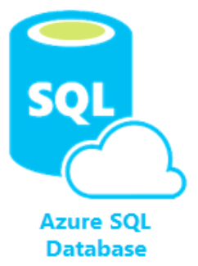
Contained Databases
A platform where all the necessities for authentication and system objects are stored in the user database…
No system databases needed, so the database is easily portable between servers…
What does this sound like?
Azure SQL Database!
Image: https://docs.microsoft.com/en-us/azure/azure-sql/database/media/sql-database-paas-overview/architecture.png
Notes:
<read slide first>
This is the whole purpose of a contained database – unlimited portability on the back end, where Microsoft can move the database from instance to instance inside Azure without having any ties to the instance, everything is contained inside the database, including authentication.
Microsoft developed this for Azure, then brought the contained database feature to SQL Server, where it’s actually labeled partially contained because of some minor details.
Now this isn’t a presentation about Azure SQL Database, but let’s talk about how the authentication and security principals here are different.

Slide 38
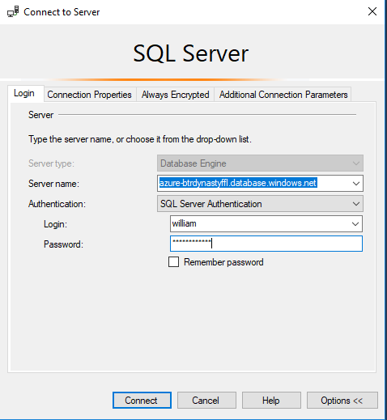
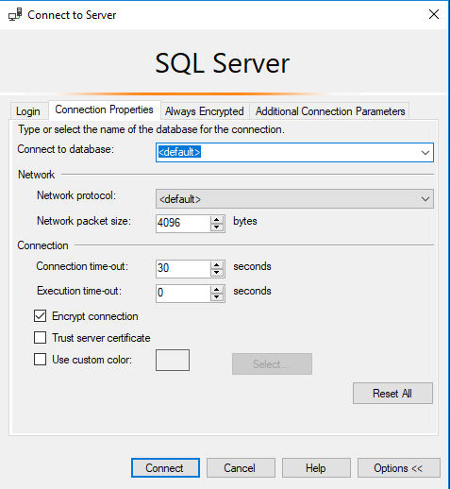
Azure SQL DB Authentication
Only real caveat when connecting to an Azure SQL DB: You youths can’t use USE, you must set the context at login.
Notes:
So get used to specifying the database connection in whatever application you’re making a connection with.

Slide 39
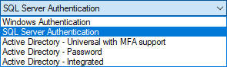
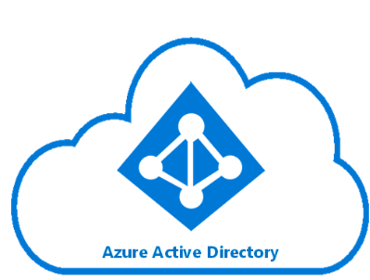
Azure SQL DB Authentication
Additional types of authentication since SSMS 2016
Image: https://docs.microsoft.com/en-us/azure/active-directory/hybrid/media/tutorial-federation/diagram.png
Notes:
The “Active Directory” dash options used for Azure AD only as replacement for the Windows Authentication option. You can of course use SQL Auth for an Azure SQL Database, and that’s really your only option for environment without an integrated Azure AD. For all the same reasons as Windows Authentication for SQL Server, using the Azure AD authentication in Azure SQL DB is superior.

Slide 40
Azure SQL Admin Logins
Azure SQL DB Servers are logical servers only.
Azure SQL Logins in master can be shared across databases.
You initially create one full admin SQL Authenticated login per Azure SQL database logical server.
You can create one Azure Active Directory administrator account with full administrative permissions as well.
You must maintain logins on each Azure SQL logical server in active geo-replication or auto-failover groups.
Notes:
<read notes instead>
Azure SQL DB Servers are logical servers only. The “master” database you see can only store certain objects.
<click>
Azure SQL Logins in master can be shared across databases, if you choose to create multiple Azure SQL databases in the same logical server.
And I say logical server because in Azure SQL DB, all the databases are contained, and behind the scenes, they may
Initially, the SQL authenticated server login account that you specify upon creating an Azure SQL DB exists as a user with administrative rights to all databases on the server.
<click>
That’s the only full admin login on the logical server that uses SQL Authentication, and you can’t create another.
<click>
You can create a second full administrator, this time using Azure Active Directory. Just like in SQL Server, it can be created for an Azure Active Directory individual account or a security group, with a security group preferred.
<click>
In Azure SQL DB, you can have logins in the master database, but more commonly you’ll have contained users in each database.
And while this is the pattern you use for a SQL Server instance, in Azure SQL Databases in active geo-replication or auto-failover groups, there’s that complexity of needing to maintain the Azure SQL DB logins on each server. Just like you would need to create and maintain the logins on each SQL Server of an availability group.

Slide 41
Azure SQL Admin Logins
You can treat Azure SQL just like SQL Server, if you want.
Contained database users can auth via SQL or Azure AD.
You must maintain logins on each Azure SQL logical server in active geo-replication or auto-failover groups.
Notes:
<read notes>
In Azure SQL DB, you can have logins in the master database, and then create non-contained users for those logins in each user database. Just like on SQL Server.
However, it’s common to have you’ll have contained users in each database, and because of the portability of the databases, rely only on contained users in each database for authentication.
<click>
Contained database users can be authenticated via SQL Authentication or via Azure AD Authentication.
<click>
If you choose to create logins in the master database and users for those logins, you get a similar complication when it comes to Azure SQL Databases in active geo-replication or auto-failover groups. If you’re not using contained users, there’s that complexity of needing to maintain the Azure SQL DB logins on each server in the group. Just like you would need to create and maintain the logins on each SQL Server of an availability group.

Slide 42
Azure SQL DB + Azure AD
You can use Azure Active Directory accounts only for Azure SQL contained database users, but not for Azure SQL server logins. Example:
CREATE USER [reportuser@domainname.onmicrosoft.com] FROM EXTERNAL PROVIDER;
You must add the Azure AD admin via the Azure Portal first.
Only Active Directory accounts can create other Active Directory accounts in Azure SQL Database.
Notes:
<read slide>
That’s really the only complication, and it’s one you’ll probably forget sooner or later. Only in Azure SQL DB, you have to be logged in with an Azure AD Account to create logins or contained users for other Azure AD Accounts.

Slide 43
Common Security Platform
Otherwise, most permissions, objects, schema, and authentication operate the same on Azure SQL Database, Azure SQL Managed Instance (MI), Azure Synapse Analytics (formerly SQL Data Warehouse), SQL Server, and SQL Server on Linux.
Notes:
<read
In this presentation when we’re talking about permissions, stored procs, views, functions, it’s probably going to be the same for any platform. Azure SQL DB and Synapse are going to have some security specific differences, we’re not going to go into them in detail, but they’re well documented.
Now, speaking of the different platforms, let’s talk a bit about how we connect to them.

Slide 44
Connection Providers
OLEDB was un-deprecated, re-released in ‘18. https://blogs.msdn.microsoft.com/sqlnativeclient/2017/10/06/announcing-the-new-release-of-ole-db-driver-for-sql-server/
Install and Convert your OLEDB connection strings from sqlncli11 or sqloledb, to the new MSOLEDBSQL.
There is also a relatively new ODBC Driver 17 for SQL Server. https://techcommunity.microsoft.com/t5/SQL-Server/ODBC-Driver-17-for-SQL-Server-Released/ba-p/385825
Both replace the OLEDB/ODBC functionality of the SQL Native Client (SNAC) which is no longer maintained.
Important to update sqlncli10 for availability groups
https://www.sqltact.com/2019/06/actual-emails-will-msoledb-work-for.html
Notes:
<read notes>
A little bit on the current state of connection providers. You might have heard that OLEDB was dead, well, long live OLEDB, it’s now a first class provider again via the new MSOLEDBSQL provider.
<click>
There’s also a relatively new ODBC driver for SQL released by Microsoft.
<click>
Both replace the OLEDB/ODBC functionality of the SQL Native Client (SNAC) which is no longer maintained. I’m talking about SNACK 10 and SNACK 11 here, avoid using those for new development, and you’ll probably have no problem switching from either to the new MSOLEDBSQL provider.
<click>
Note that for the SNACK10, which we released with SQL 2008, doesn’t have the parameters needed for successful connections to availability groups, and so that can be a hurdle to overcome for applications to start connecting to SQL Servers that have been migrated to availability groups.
Again if you have any questions, please use the Audience Response System to ask and I’ll do my best to answer after the session.
Ok, this is a security presentation, enough about authentication, let’s talk permissions inside the server and inside the database.

Slide 45
Basic User Permissions
DML*
DDL**
Modify Security
SELECT
DELETE
UPDATE
INSERT
REFERENCES
*Data Manipulation Language
ALTER
CONTROL
VIEW DEFINITION
CREATE
DROP
EXECUTE **Data Definition Language
GRANT
REVOKE
DENY
IMPERSONATE
Notes:
Some basic permissions broken down here into three categories, some of these you’re probably already familiar with.

Slide 46
Common Permissions for Non-Sysadmins
ALTER TRACE For SQL Profiler and traces
ALTER ANY EVENT SESSION For XEvents (replaces traces!)
VIEW SERVER STATE For server DMV’s, XEvents
VIEW DATABASE STATE For database-level DMV’s
VIEW ANY DEFINITION For definitions of objects
GRANT VIEW SERVER STATE TO [SPARK\william.assaf];
_____________________________________________________
GRANT VIEW SERVER STATE TO [SPARK\DBA_team];
Notes:
<read slide>
Example:
These permissions are given by the GRANT syntax GRANT VIEW SERVER STATE TO [SPARK\william.assaf];
Except remember, I shouldn’t be granting permissions to any one individual, I should be granting permissions to a team!

Slide 47
Sample Permissions Scenario
GRANT SELECT ON game.PingPongScore TO [DOM\a_Gump];
GRANT EXECUTE ON game.GetScore TO [DOM\a_Gump];
GRANT EXECUTE TO [DOM\a_Gump]; --in current db context
GRANT VIEW DEFINITION ON game.GetScore TO [DOM\a_Gump];
GRANT ALTER ANY EVENT SESSION TO [DOM\a_Gump];
GRANT VIEW SERVER STATE TO [DOM\a_Gump];
Notes:
<read slide first>
And then of course because this is in production and I’m a responsible DBA, I would have scripted this all out, changed all the GRANTs to REVOKEs, and removed all those excess temporary permissions.
One more detail, I have been granting these permissions to developer Gump’s admin account. Different enterprises use different naming conventions for their admin accounts vs their day to day accounts, it doesn’t really matter to me, but what does matter is that most IT staff have two accounts, one for day to day access, one for admin access. Let’s talk about that more.

Slide 48
Admin Accounts vs Day-to-Day Accounts
All Administrators (including DBA’s) should have two accounts: one for day-to-day workstation/email/Teams/intranet access, one for production admin-level access only.
Day-to-day accounts may have Production read-only access to non-sensitive databases, including metadata, job status and history, error logs, SSISDB logs, logging databases, etc.
The same domain accounts that have production access should not have VPN/remote access.
Notes:
<read notes>
This is a security presentation so we have to talk about how we as DBA’s handle our own credentials and access to SQL data.
This isn’t uncommon, many of my clients in my consulting past already have this type of setup in place, but many of them also are lax about admin permissions for day-to-day accounts, or overuse of admin accounts for services, etc.
So here are some rules we need to stick to as professionals. Everyone should have two accounts, in your corporate enterprise Active Directory, and we gotta keep em separated.
<read slide>

Slide 49
Common Permissions for Non-Sysadmins
SHOWPLAN - Viewing execution plan for executable query
IMPERSONATE - Allows testing rights with EXECUTE AS
CONNECT ALL DATABASES - Allows the login to set any database context (USE) but grants no other rights in each database, potentially appropriate for day-to-day accounts
SELECT ALL USER SECURABLES - SELECT from all objects in ALL db’s, potentially appropriate for day-to-day accounts, but probably not – be aware of your regulatory restrictions.
Notes:
Now I just talked about day to day accounts vs admin accounts.

Slide 50
CONTROL Permissions
CONTROL SERVER - Effectively the same as sysadmin. Not for non-admins.*
CONTROL DATABASE - Effectively the same as db_owner. Not for non-admins.*
*One big difference: CONTROL permissions can be affected by DENY, but sysadmin/db_owner cannot.
Let’s demonstrate…
Notes:
<read notes>
So we talked about the sysadmin server role, which is the everything permission, and we talked about the db_owner role in each database, which is the everything permission in each database. These are commonly granted to admins.
Some other permissions you might find useful are the CONTROL permissions. These are most useful if you’re trying to craft a permissions set for an admin that is just short of sysadmin, for example, something that has access to maintain the server but not certain key activities or databases.
<click>
One big difference between the sysadmin or db_owner roles and the CONTROL permissions are that CONTROL permissions can be affected by DENY, but sysadmin/db_owner cannot.
<click>

Slide 51
Testing Permissions with EXECUTE AS
USE [master];
CREATE LOGIN [dom\username] FROM WINDOWS;
GRANT CONTROL SERVER TO [dom\username];
DENY VIEW SERVER STATE TO [dom\username];
EXECUTE AS LOGIN = 'dom\username';
SELECT * FROM sys.dm_exec_cached_plans; --Fails
GO
REVERT; --Reverts the EXECUTE AS
Notes:
Here let’s demonstrate how control permissions can be denied, and also the EXECUTE AS permission I mentioned earlier, for trying out permissions of another user.

Slide 52
Testing Permissions with EXECUTE AS
EXECUTE AS makes it possible for you to simulate the permissions of another principal in your current session.
Always follow an EXECUTE AS with a REVERT, which stops impersonation. A REVERT affects only one EXECUTE AS.
During testing, display what principal you are: SELECT ORIGINAL_LOGIN(), CURRENT_USER;
ORIGINAL_LOGIN() The name of the login with which you actually connected. This will not change even after you use EXECUTE AS USER or EXECUTE AS LOGIN.
CURRENT_USER. The name of the user you have assumed.
Notes:
<read slide>
Alright, we’ve covered, authentication and permissions, let’s talk about some more advanced security topics, ones that everyone needs to be aware of. Let’s start with SQL Injection.

Slide 53

SQL INJECTION
https://xkcd.com/327/

Slide 54
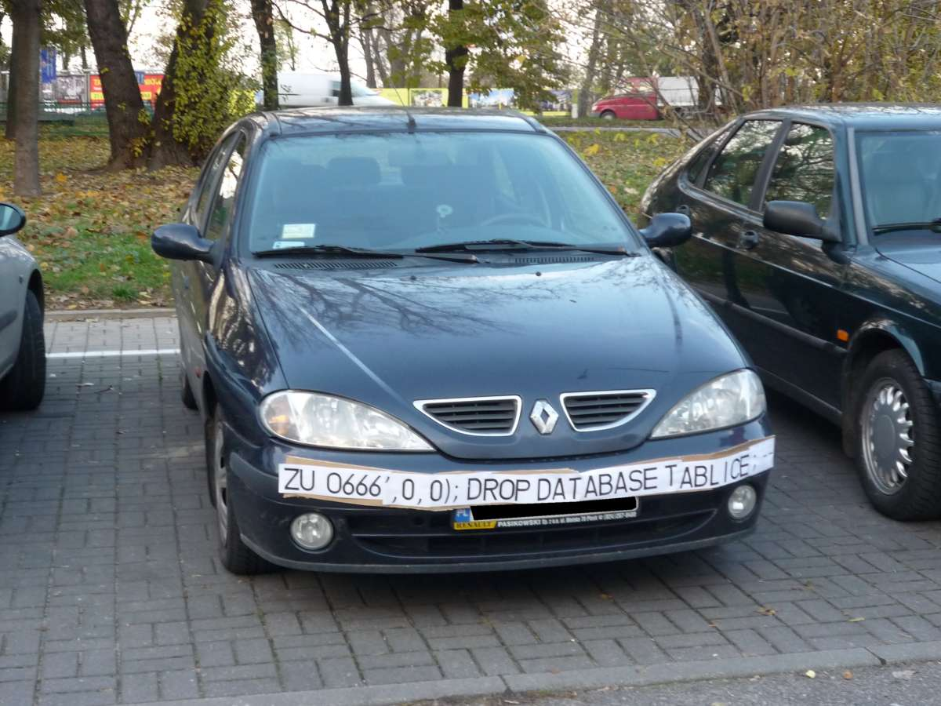
SQL INJECTION

Slide 55
SQL Injection
This is a much larger topic with lots of info out there.
SQL Server is better than some RDBMS platforms but is not immune to SQL Injection attacks made possible by security-ignorant development.
Developers must be aware of SQL Injection-blocking patterns on public websites:
Parameterize the input from the website (use sprocs!)
Sanitize inputs of special characters
Don’t run websites logins with more databases permission than needed (again, use sprocs!)

Slide 56
what can you do to prevent SQL Injection?
Design tables with appropriate data types and lengths.
Insist on stored procedures for public-facing operations like searches. Be aware of what db’s have public apps.
Insist on stored procedures for Entity Framework (or other ORMs) operations involving 2+ entities.

Slide 57
what can you do to prevent SQL Injection?
Avoid apps running with permissions like the db_datareader and db_datawriter roles, and certainly not db_owner.
Avoid the use of EXECUTE AS in code, which could allow injected code to execute with elevated security.
Train devs on patterns of stored procedure parameter sanitizing. Never use EXEC() or sp_executesql with user-enterable data.

Slide 58
what can you do to prevent SQL Injection?
Provide links, attention, and visibility to PM’s and Dev’s for SQL Injection awareness.
Lobby for penetration testing and SQL Injection detection tasks in sprints.
With Azure SQL DB, enable Azure Threat Detection!

Slide 59
AZURE threat detection
Azure SQL Database Threat Detection is a security intelligence feature built into the Azure SQL Database, activated with a button click.
Detects potential vulnerabilities such as Potential SQL Injection attacks, brute force attacks, anomalous login patterns, and more.

Slide 60
Feature Restrictions
Azure SQL Database and SQL Server 2019 have a pair of minor anti-injection feature to disable a pair of common probing attacks.
An injection attack will use delay or error messages to probe for vulnerabilities. An Error Message could contain object names.
You can disable WAITFOR and all error messages for a database user or role. For example:
EXEC sp_add_feature_restriction N'ErrorMessages', N'User', N’WebUser’
EXEC sp_add_feature_restriction N’WaitFor', N'User', N’WebUser’
Bypassed if running your website as a sysadmin or db_owner!
Learn more: https://docs.microsoft.com/en-us/azure/sql-database/sql-database-feature-restrictions

Slide 61
SSMS Vulnerability Assessment
Built into SSMS, there is a Vulnerability Assessment tool available via Object Explorer in each Database -> Tasks.
Introduced in SSMS 17.4 in SQL 2017.
Many findings have to do with database-level permissions that we’re discussing today: PUBLIC, GUEST, user-defined roles, low-impact roles, orphaned roles, least privilege, and more.

Slide 62
Stored procedures
Stored procedures require EXECUTE to run, and do not require all underlying object permissions (SELECT, INSERT, DELETE)…
…provided that the sproc doesn’t perform IDENTITY_INSERT on a table, which requires ALTER permissions not abstracted.
…provided that all the underlying objects have the same ownership chain.
…provided that the stored procedures do not use dynamic sql commands exec sp_executesql @SQL or EXEC(@SQL)

Slide 63
Stored procedures
Given those conditions, thanks to the database permission chain, you can:
GRANT EXEC rights to sprocs that INSERT UPDATE and SELECT from a table.
GRANT no other permissions to the table!
The user can read data in the table using the sproc ONLY.

Slide 64
Stored procedures
Consider DENYing SELECT rights to the public role, which is inherited by all user roles aside from db_owner and sysadmin.
Users prevented from accessing any tables or views directly from any application (SSMS, Access, Excel!).
User access to data is forced through sprocs. (Good!)

Slide 65
Views
Similar to stored procedures, a VIEW will allow a user to SELECT data from tables to which the user does not have access. (This is helpful!)

Slide 66
User-Defined Functions (UDF)
Similar to stored procedures, a UDF will allow a user to SELECT data from tables that the user does not have access to.
Keep in mind the performance impact of functions can be severe, especially in the SELECT portion of a query.
Overuse of UDF’s are common causes for performance issues. High potential for cursor-like effects.

Slide 67
laB
Demonstrate how Stored Procedures, Views, and Functions abstract the permissions necessary to view underlying table data.
Toolbox\Security p1.sql – logged in as sysadmin
Toolbox\Security p2.sql – logged in as testing user

Slide 68
Builtin\administratorS
Prior to SQL 2008, [BUILTIN\Administrators] was a member of the SQL sysadmin role.
This was a security hole – allowing anyone who gained admin access to a Windows Server to automatically and easily have sysadmin access.
SQL 2008 – BUILTIN\Administrators no longer have automatic rights to the SQL server and should NOT be granted access.

Slide 69
dbo
In SQL 2000, sales.dbo.customers meant:
databasename = sales
owner = dbo
tablename = customers
In 2005 and later, sales.dbo.customers meant:
databasename = sales
schema = dbo
tablename = customers

Slide 70
dbo
In SQL 2000, dbo was a special user inside each database with sysadmin permissions, which by default owned any object created by an admin.
In SQL 2005 and above, dbo is the default schema and no longer a security object. Saying a user has “dbo permissions” is incorrect.
[db_owner] is just a user role with no server-level permissions.

Slide 71
ownership
Microsoft has done away with the terminology of Users or Logins “owning” objects, such as databases and schemas.
Changing the AUTHORIZATION is now the more accurate term to describe “ownership” of an object.
For example, sp_changedbowner is deprecated, replaced by ALTER AUTHORIZATION

Slide 72
Schemas
A schema is a securable container
It contains database of objects, by default objects are inside the internal “dbo” schema.
Additional user schemas can be created. Permissions can be granted to schemas as a set.
Examples:
logical [Staging], [ODS], [Audit], [WH]
business [Sales], [HR], [Acct], [Inv]

Slide 73
Cross database ownership
A sproc/view can return data from a table in another database without permissions, if the two databases share the same owner login, by enabling Cross-Database Ownership Chaining on both databases.
This is not enabled by default on user databases. It has to be enabled at the server level then activated in each database…

Slide 74
Cross database ownership
Any login can take advantage of Cross-Database Ownership Chaining from another database.
Stored procedures and views – not queries - can then query other databases without any additional permissions.
Which could be very helpful, or a security risk…

Slide 75
Cross database ownership
It is possible that cross-database ownership can bypass your permissions by querying from the context of another database!
Enabling Cross-Database Ownership Chaining increases the necessary complexity of securing your data with minimum permissions.
You probably don’t need it, do it right.

Slide 76
Application roles
By executing sp_setapprole, a user connection inherits the permissions of an app role.
The application role has no permanent members, but is assigned permissions and given an app-only password.
The user connection assumes only the permissions of the application role.
You can utilize Active Directory-based Windows authentication without giving direct permissions.
Can be part of a strategy to force use of database to occur only via the application.

Slide 77
Application roles
Cons:
Accessing other databases requires the use of the guest role.
Connection pooling can be problematic (cookies)

Slide 78
Continued reading
http://msdn.microsoft.com/en-us/library/ms191291.aspx
https://docs.microsoft.com/en-us/sql/connect/oledb/oledb-driver-for-sql-server?view=sql-server-2017
https://blogs.msdn.microsoft.com/sqlnativeclient/2017/10/06/announcing-the-new-release-of-ole-db-driver-for-sql-server/
https://techcommunity.microsoft.com/t5/SQL-Server/ODBC-Driver-17-for-SQL-Server-Released/ba-p/385825
http://social.technet.microsoft.com/wiki/cfs-file.ashx/__key/communityserver-wikis-components-files/00-00-00-00-05/5710.Permissions_5F00_Poster_5F00_2008_5F00_R2_5F00_Wiki.pdf
http://msdn.microsoft.com/en-us/library/bb669058(v=VS.110).aspx
http://blogs.msdn.com/b/sqlsecurity/archive/2011/08/25/database-engine-permission-basics.aspx
http://msdn.microsoft.com/en-us/library/ms191465.aspx
https://docs.microsoft.com/en-us/sql/relational-databases/databases/security-best-practices-with-contained-databases?view=sql-server-2017
https://azure.microsoft.com/en-us/blog/azure-sql-database-threat-detection-your-built-in-security-expert/
https://www.slideshare.net/GrantFritchey/sql-injection-what-it-is-how-to-stop-it
http://technet.microsoft.com/en-us/library/ms187359.aspx
http://support.microsoft.com/kb/918992
https://azure.microsoft.com/en-us/documentation/articles/sql-database-aad-authentication/
https://azure.microsoft.com/en-us/documentation/articles/sql-database-manage-logins/

Slide 79

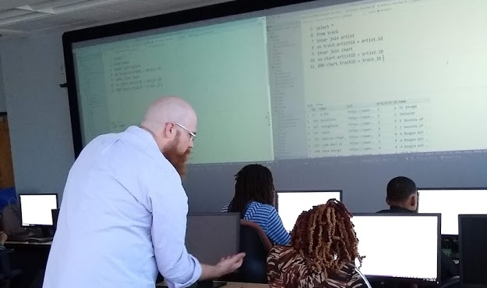
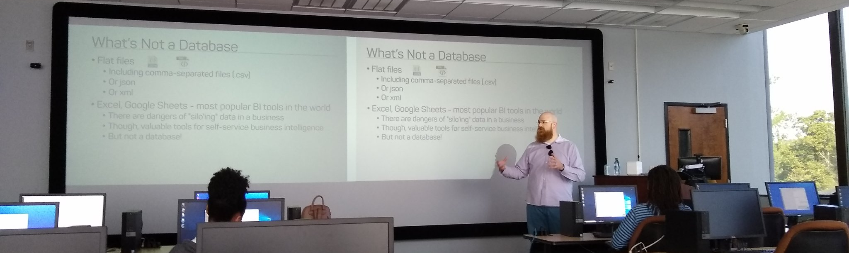
Support your Local STEM Initiatives
https://www.thewallsproject.org/programs/futures_fund/
Notes:
I encourage you to find, then donate time and money to local STEM education initiatives where you live. Get involved in the nonprofits doing STEM education local to you, I’m sure you’re out there, last year I ran for the PASS board on a platform of trying to help PASS activate its membership to get more involved in partnering with local STEM nonprofits especially those in underserved public schools. There is almost certainly some nonprofit where you live that needs your enthusiasm and skills to close the opportunity gap.

Slide 80
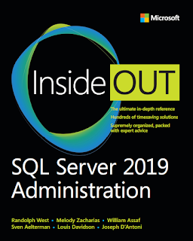
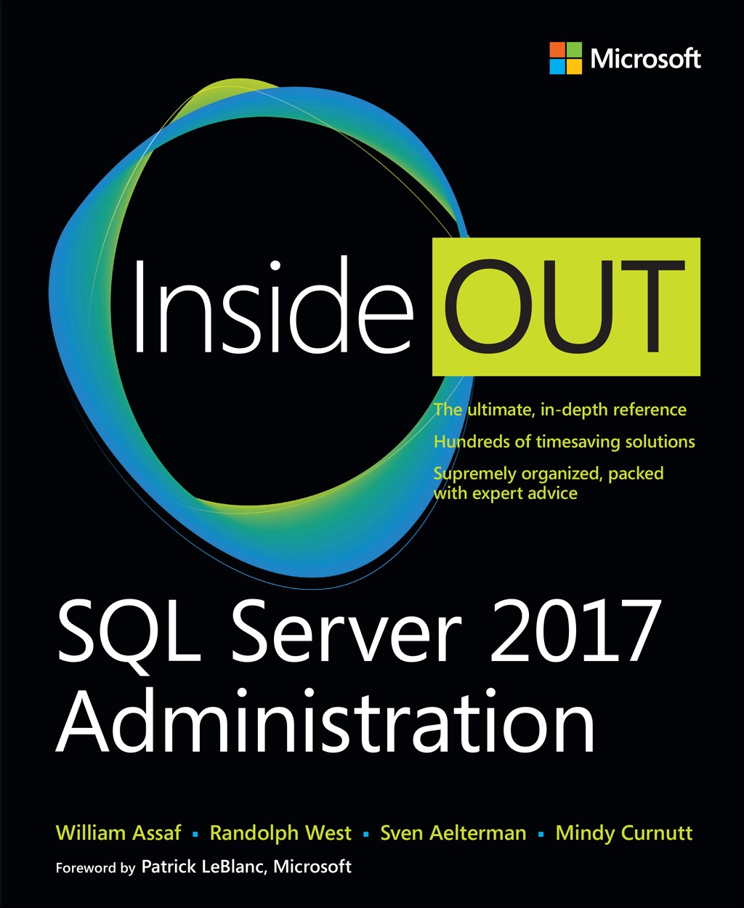
SQL Server 2017 Inside Out
SQL Server 2019 Administration Inside Out
by Microsoft Press
2017 published Feb 2018
2019 coming March 2020

Slide 81
William Assaf
Principal Consultant, Microsoft MVP, PASS Regional Mentor
He/Him
Title
Company
in/williamdassaf
@william_a_dba
SQLTact.com
Co-author, Microsoft Press, SQL Server Administration Inside Out 2017, 2019

